Slide 1
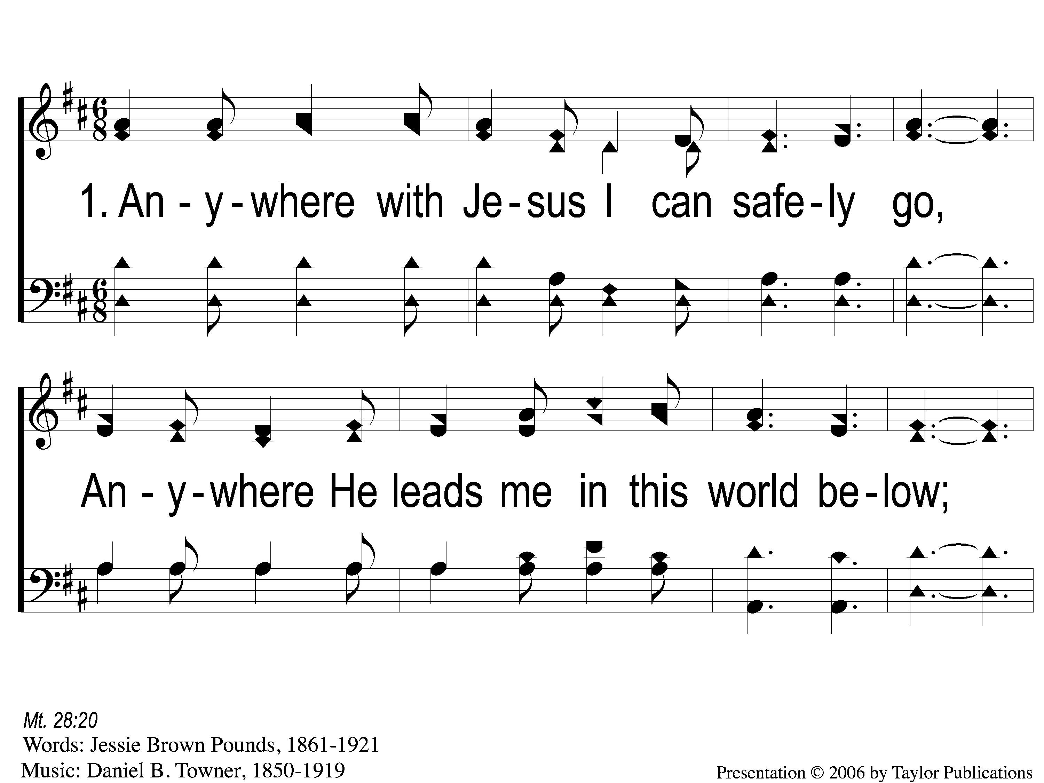
1-1 Anywhere with Jesus
Anywhere With Jesus
414

Slide 2
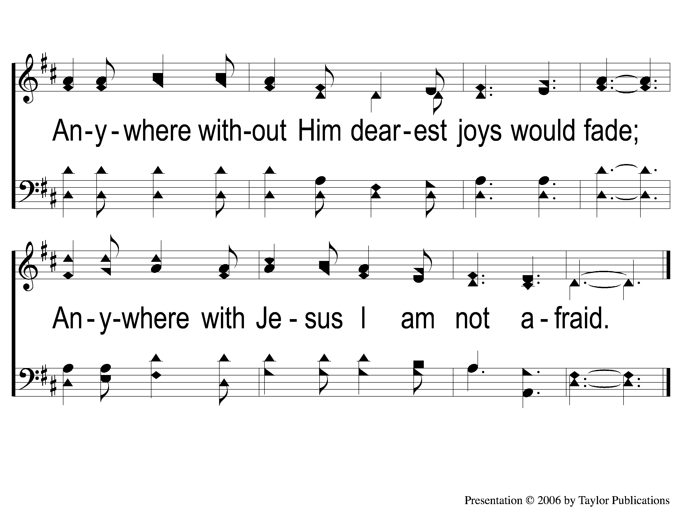
1-2 Anywhere with Jesus
Anywhere With Jesus
414

Slide 3
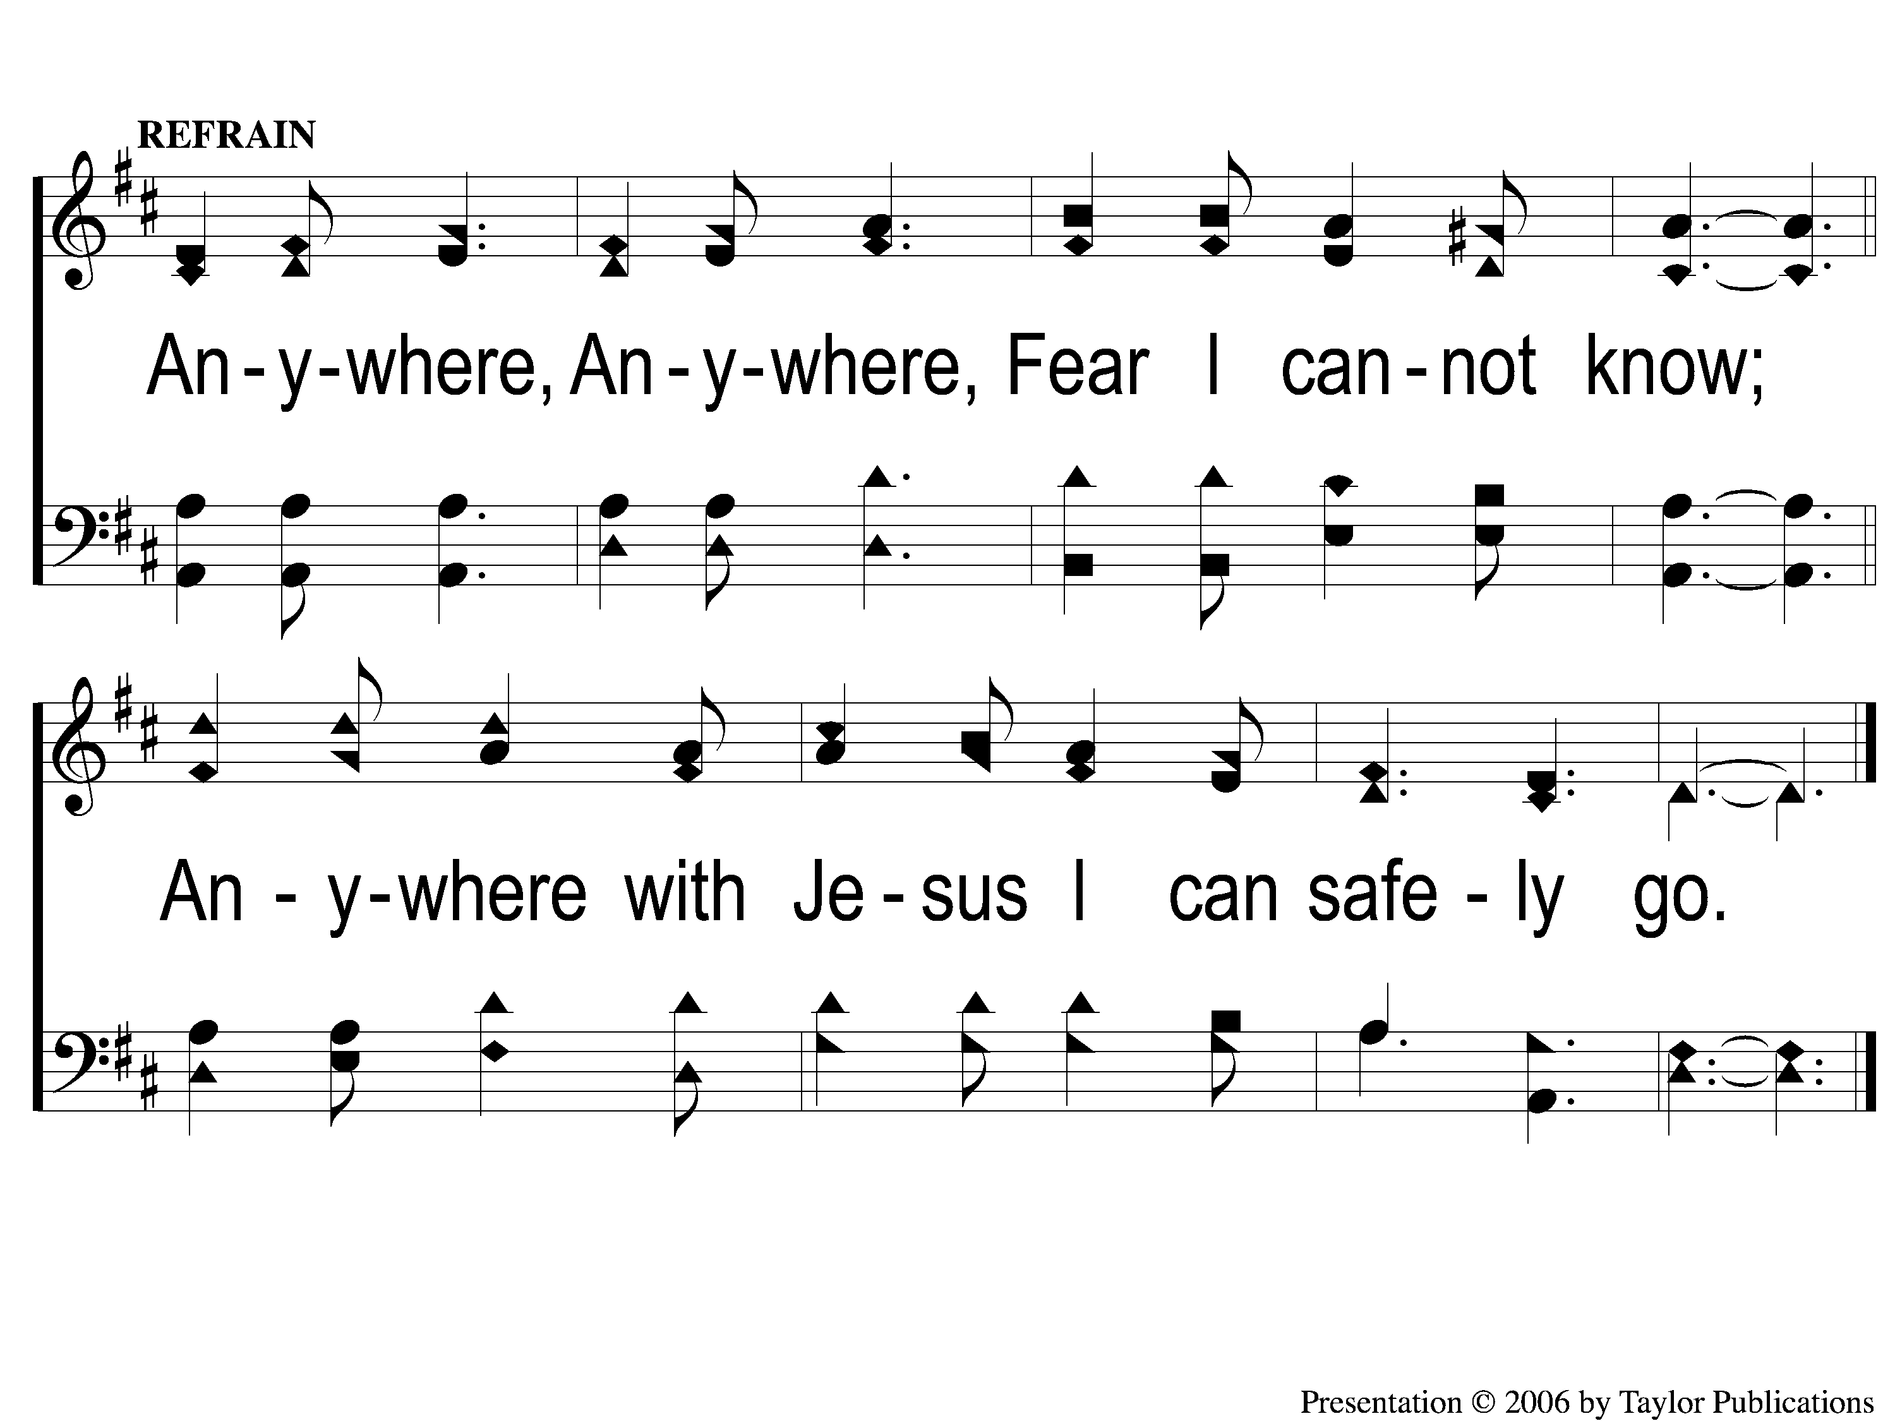
C-1 Anywhere with Jesus
Anywhere With Jesus
414

Slide 4
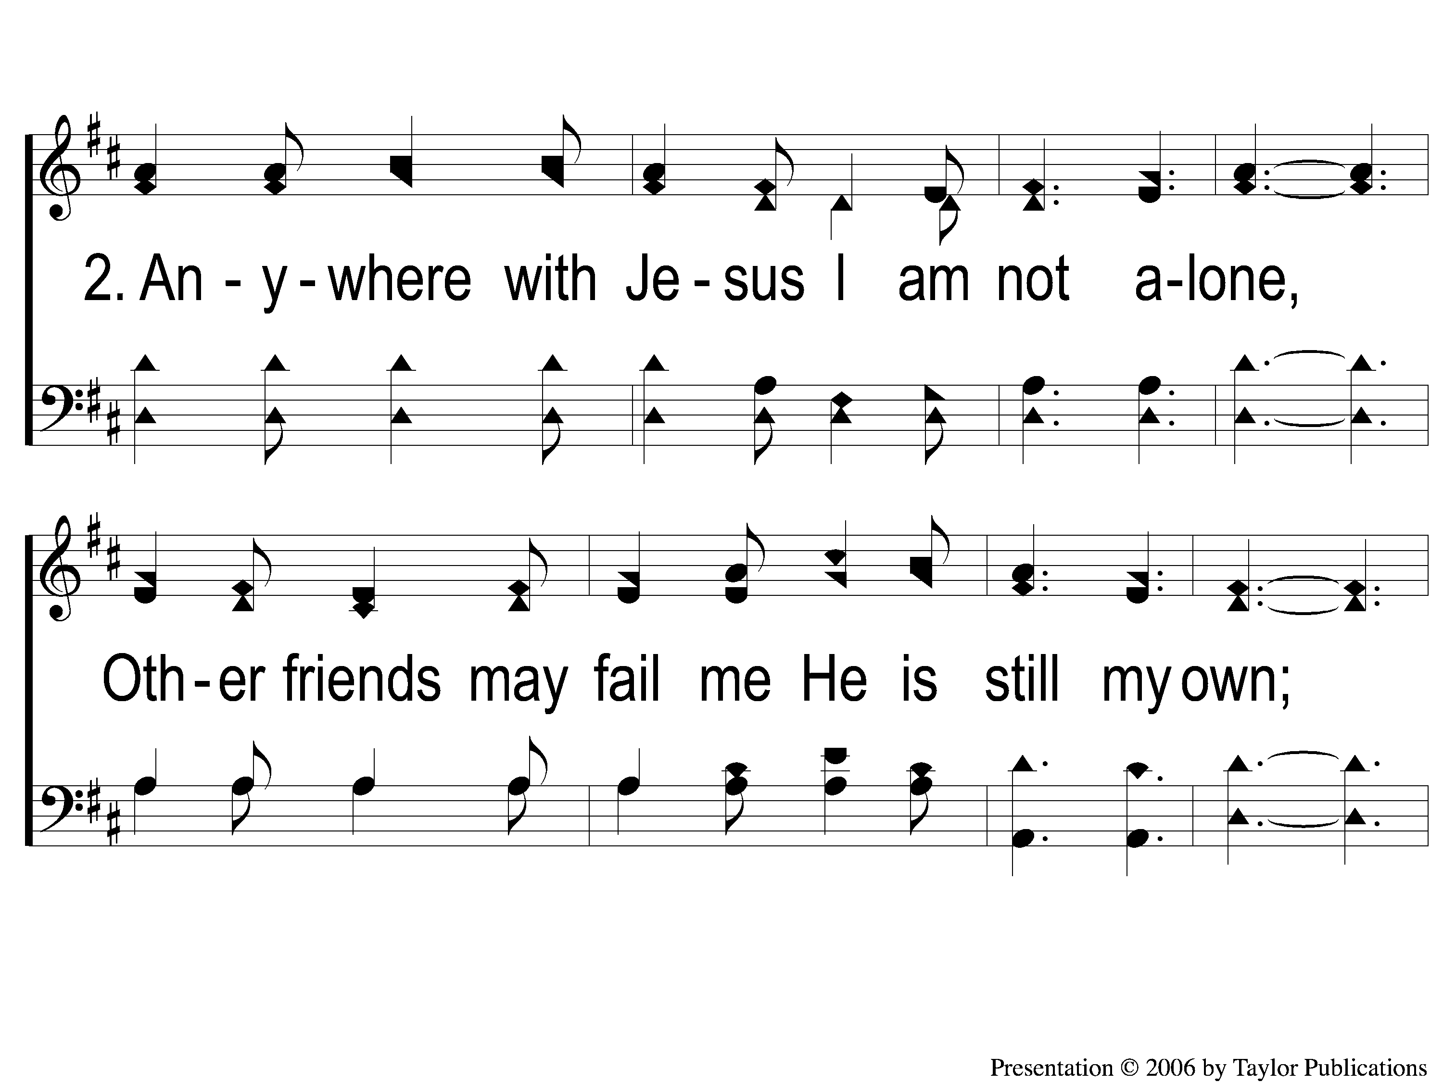
2-1 Anywhere with Jesus
Anywhere With Jesus
414

Slide 5
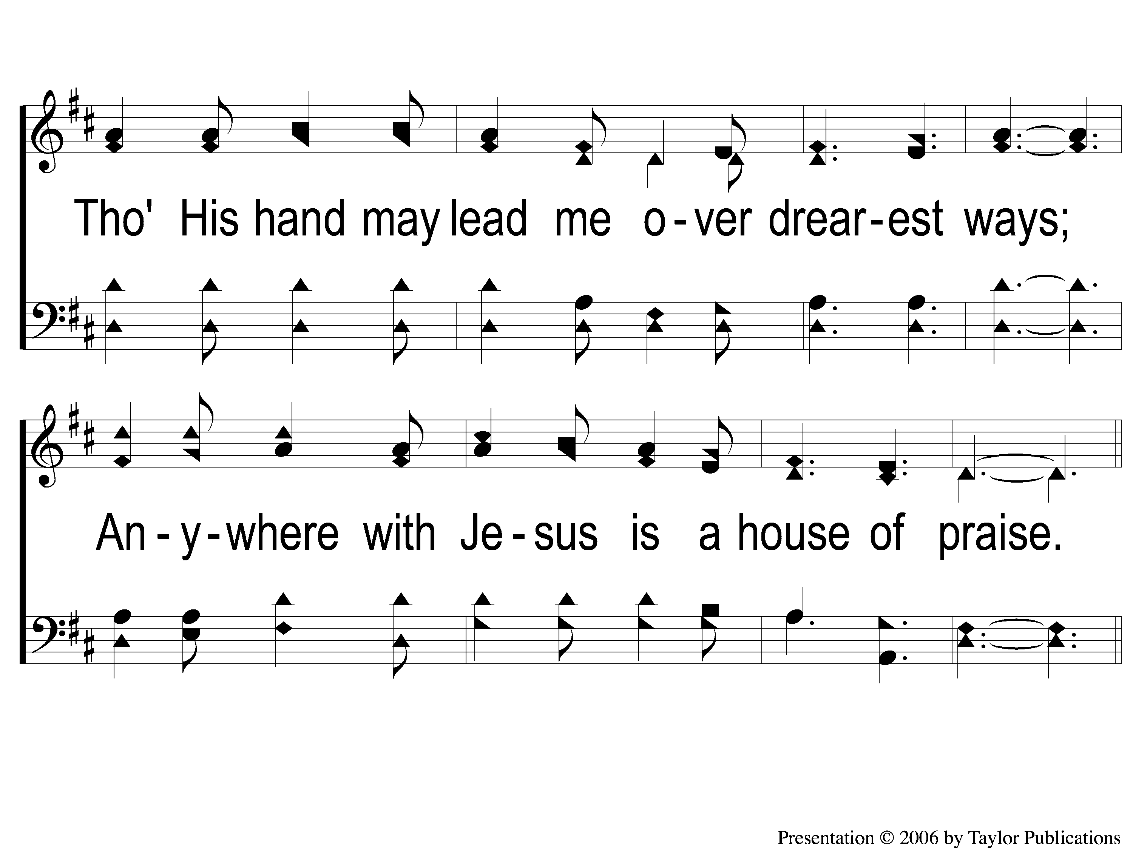
2-2 Anywhere with Jesus
Anywhere With Jesus
414

Slide 6
C-1 Anywhere with Jesus
Anywhere With Jesus
414

Slide 7
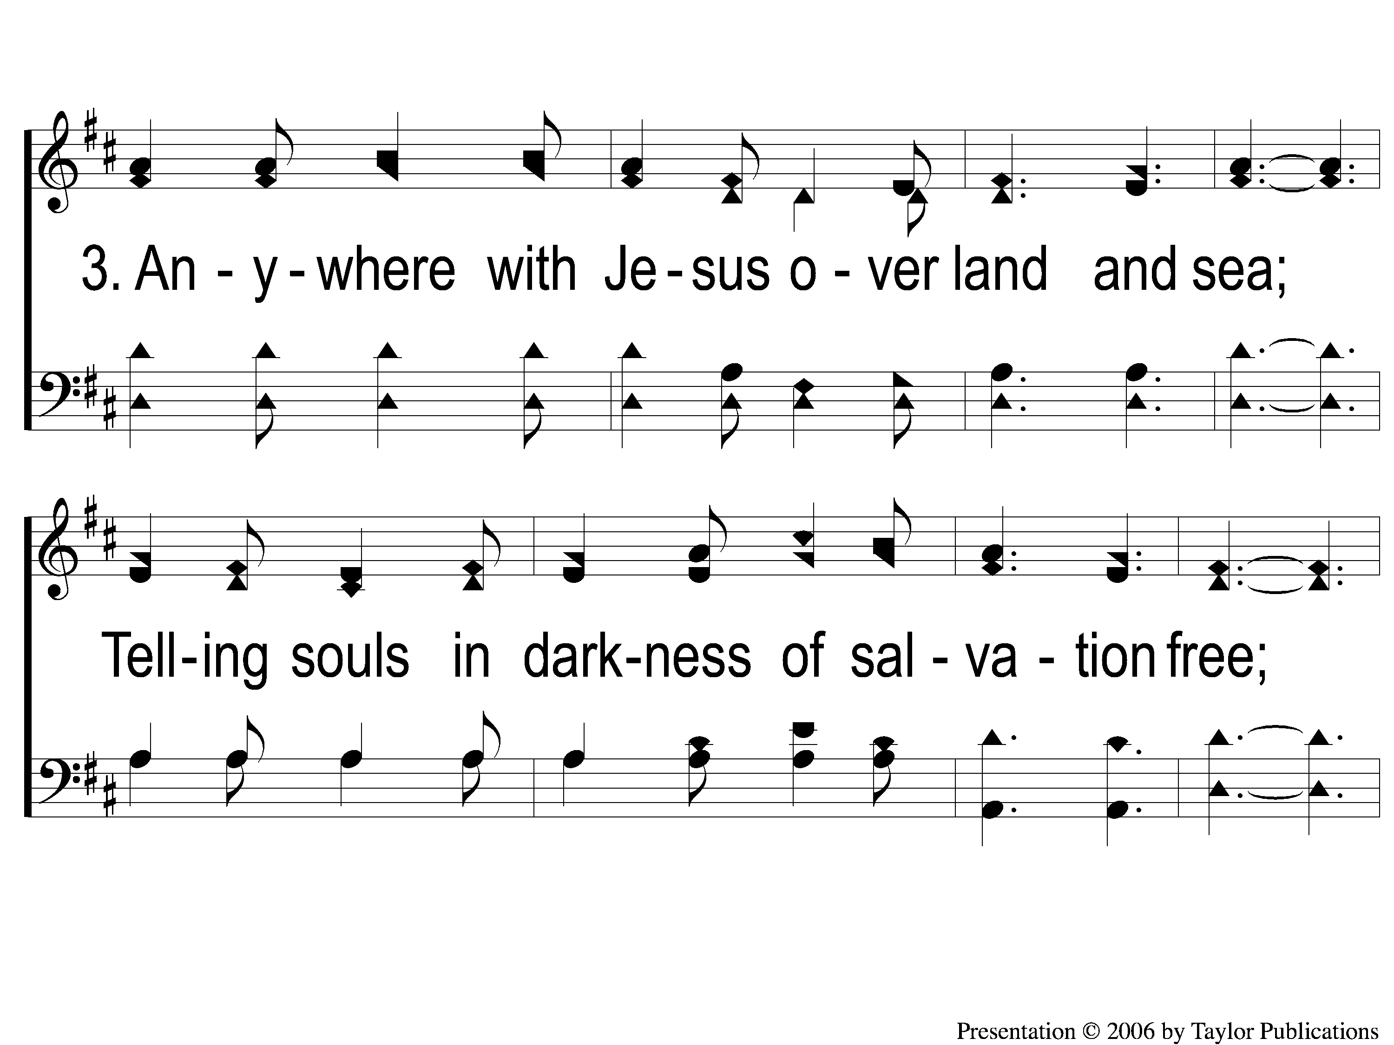
3-1 Anywhere with Jesus
Anywhere With Jesus
414

Slide 8
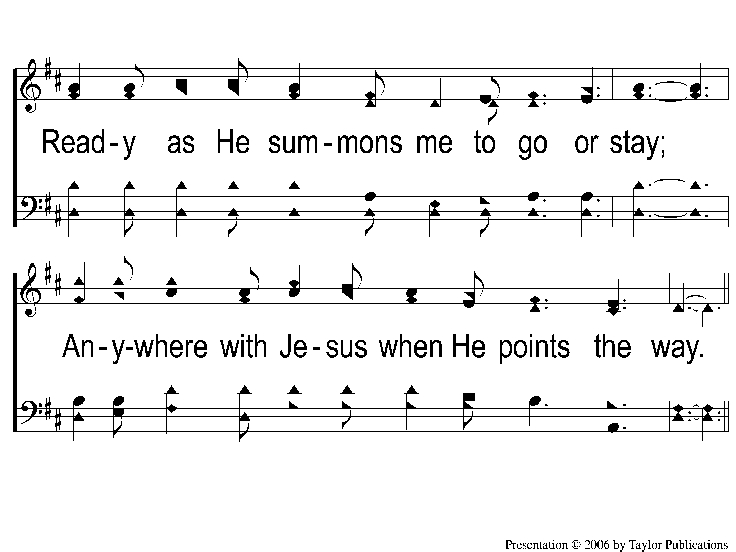
3-2 Anywhere with Jesus
Anywhere With Jesus
414

Slide 9
C-1 Anywhere with Jesus
Anywhere With Jesus
414

Slide 10
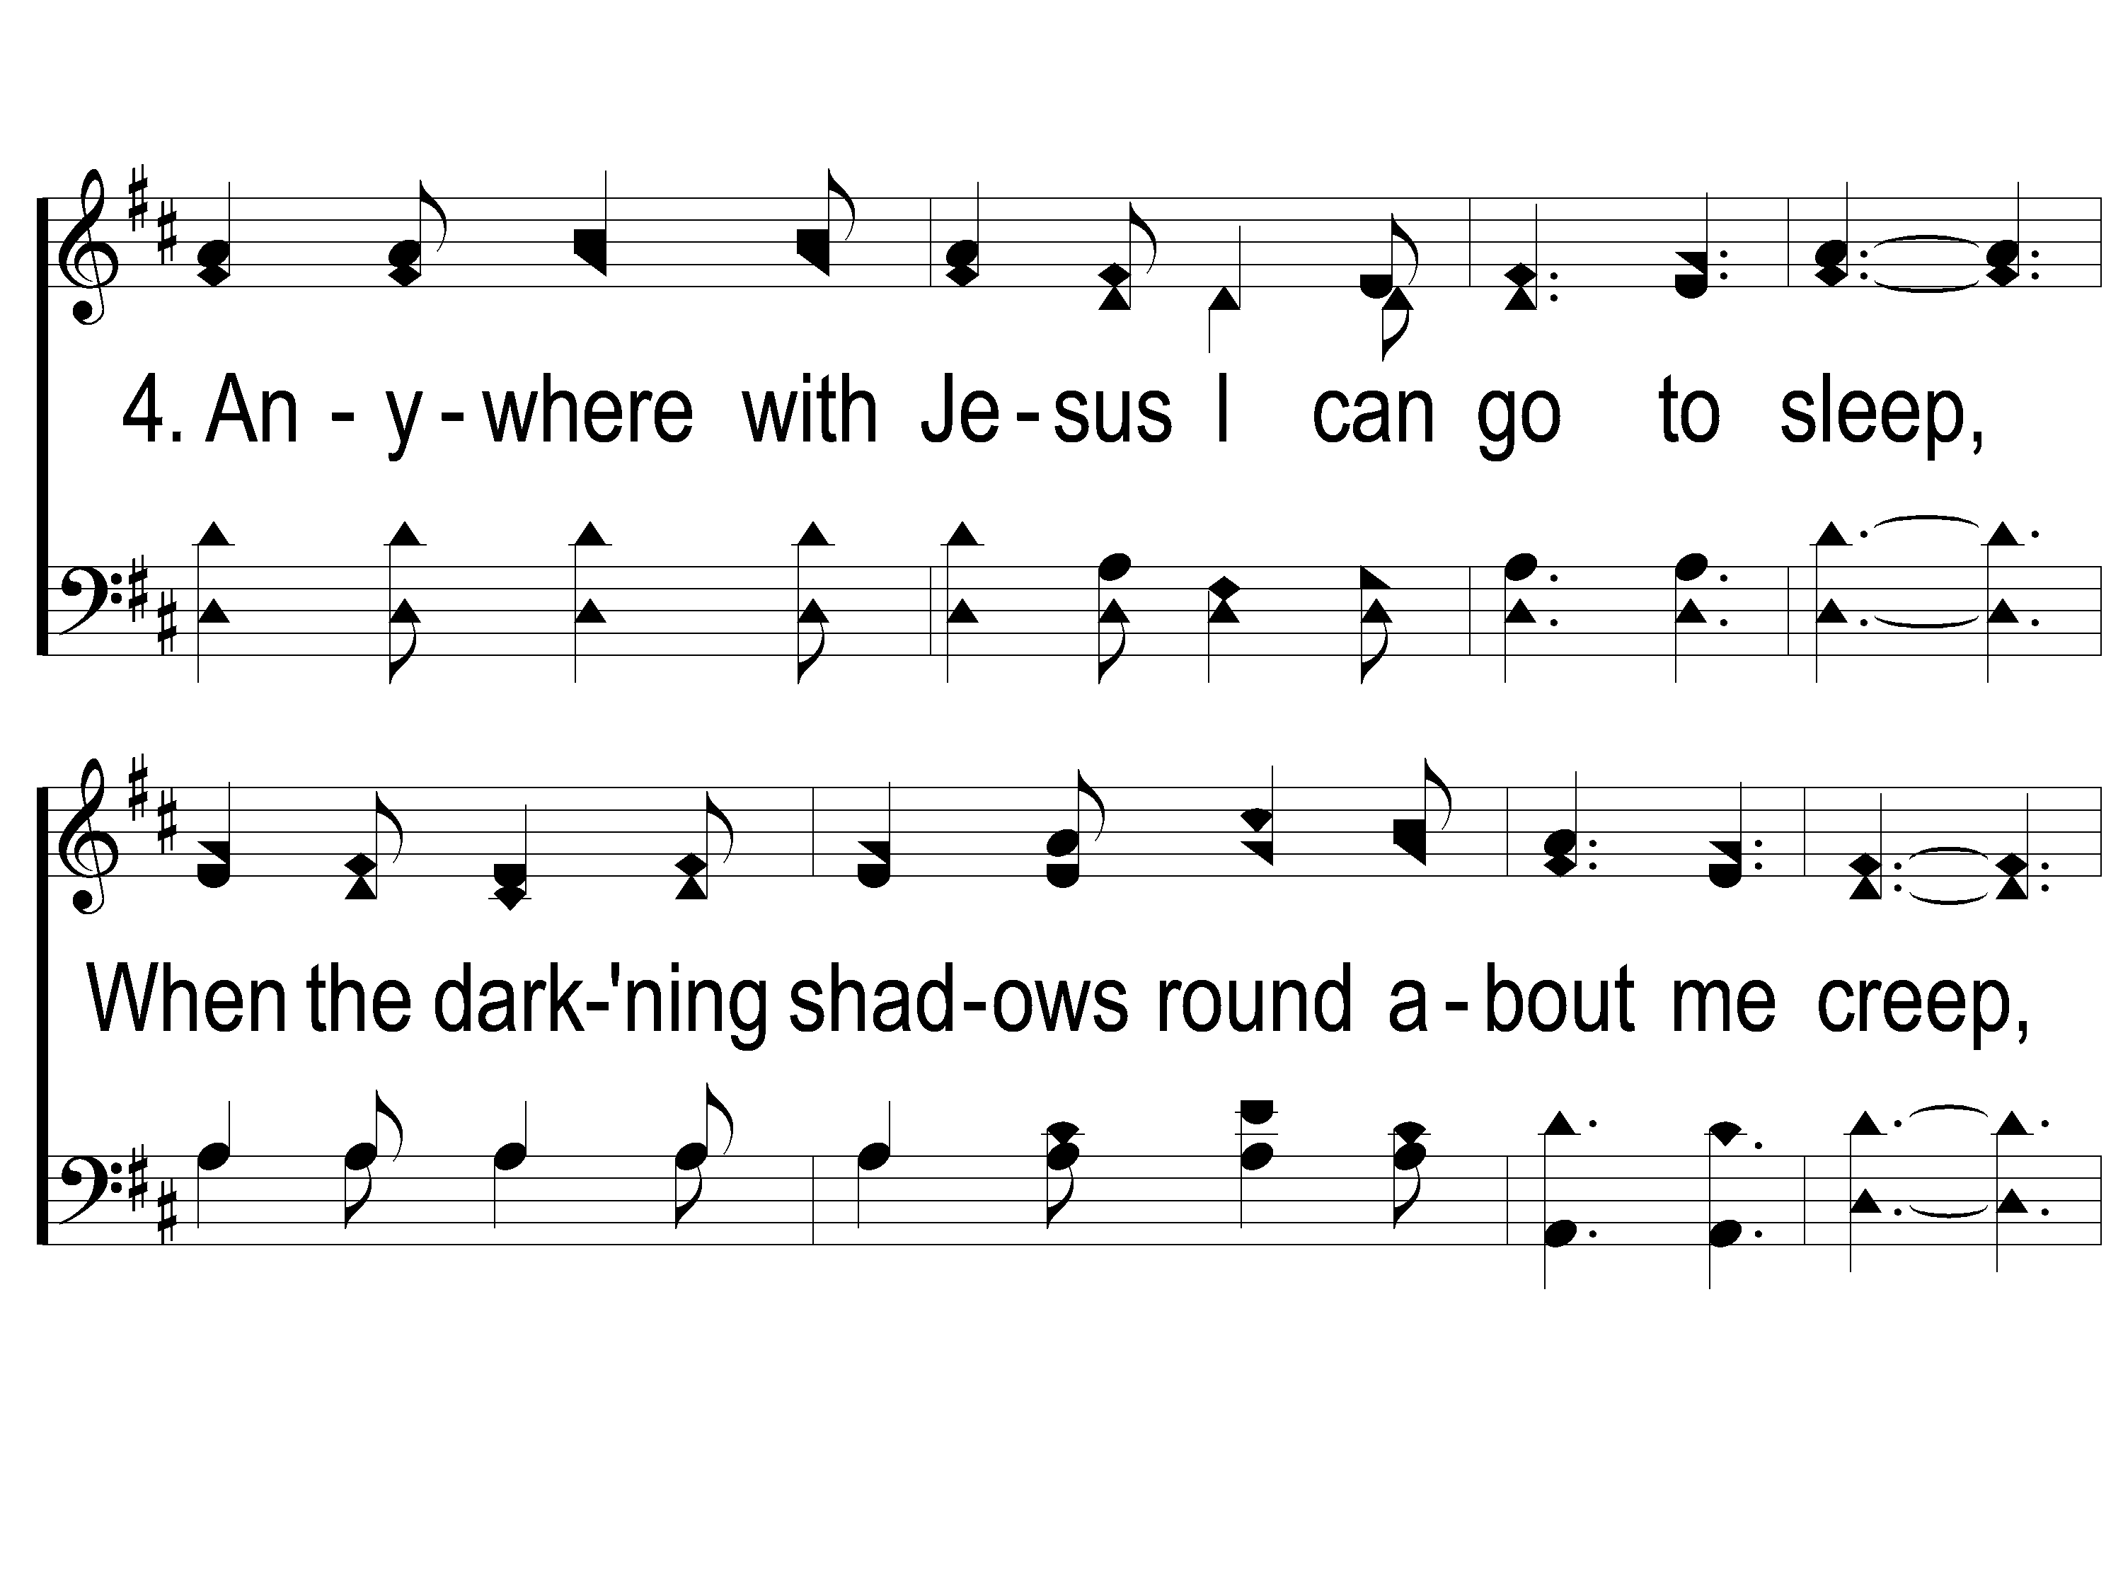
4-1 Anywhere with Jesus
Anywhere With Jesus
414

Slide 11
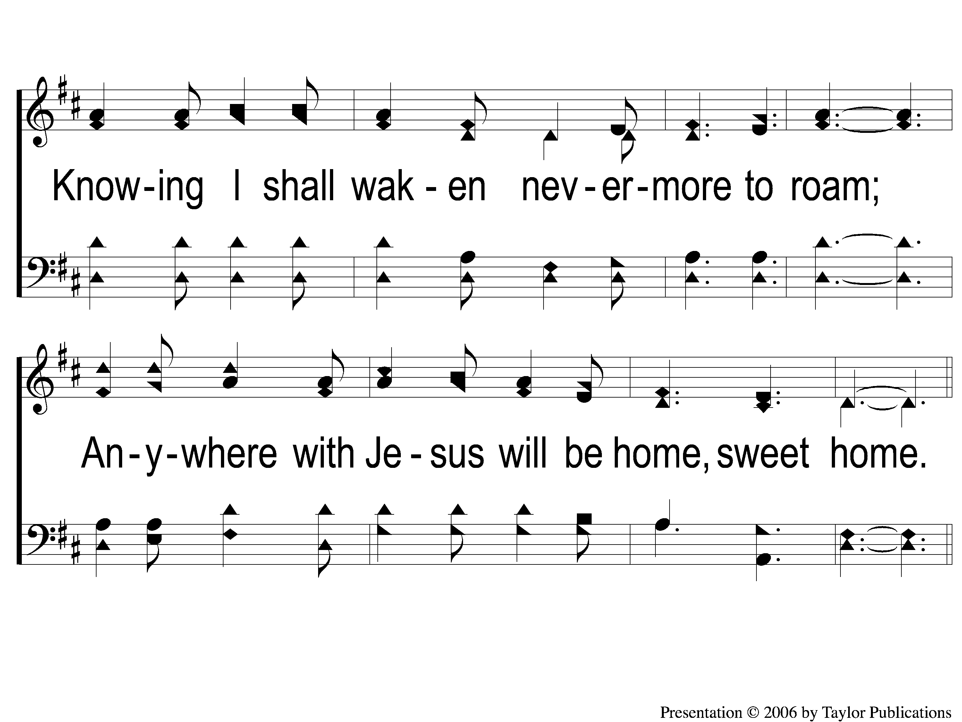
4-2 Anywhere with Jesus
Anywhere With Jesus
414

Slide 12
C-1 Anywhere with Jesus
Anywhere With Jesus
414

